Slide 1
ESc201 : Introduction to Electronics
Number System
Vipul Arora
Dept. of Electrical Engineering
IIT Kanpur
Mar 20, 2023

Slide 2
Writing Numbers
1
2
3
4
5
6
7
8
9
a
b
c
d
e
f
g
h
i
j
k
...
!
@
#
Better to write as 10, 11, 12
Fixed number of symbols + Compositionality
How many basic symbols?
Why 10, why not 2 or 5 or 8 or 16?

Slide 3
Numbers
Every number system is associated with a base or radix (no. of symbols)
A positional notation is commonly used to express numbers
The decimal system has a base of 10 and uses symbols (0,1,2,3,4,5,6,7,8,9) to represent numbers

Slide 4
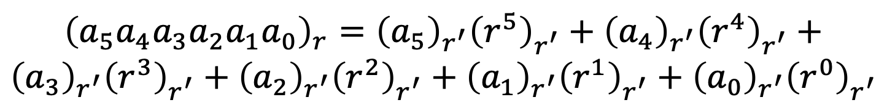
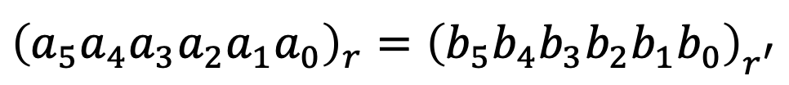
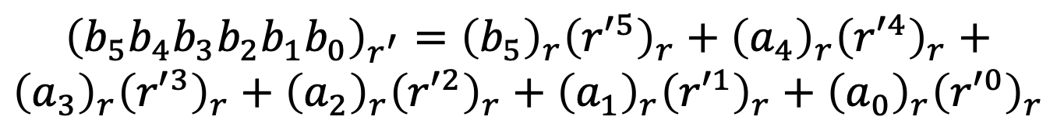
Numbers
Every number system is associated with a base or radix (no. of symbols)
A positional notation is commonly used to express numbers
$${\left(a_{5}a_{4}a_{3}a_{2}a_{1}a_{0}\right)}_{r}={\left(b_{5}b_{4}b_{3}b_{2}b_{1}b_{0}\right)}_{r^{′}}^{ }$$
$${\left(a_{5}a_{4}a_{3}a_{2}a_{1}a_{0}\right)}_{r}={{\left(a_{5}\right)}_{r^{′}}\left(r^{5}\right)}_{r^{′}}^{ }+{{\left(a_{4}\right)}_{r^{′}}\left(r^{4}\right)}_{r^{′}}^{ }+$$
$${{\left(a_{3}\right)}_{r^{′}}\left(r^{3}\right)}_{r^{′}}^{ }+{{\left(a_{2}\right)}_{r^{′}}\left(r^{2}\right)}_{r^{′}}^{ }+{{\left(a_{1}\right)}_{r^{′}}\left(r^{1}\right)}_{r^{′}}^{ }+{{\left(a_{0}\right)}_{r^{′}}\left(r^{0}\right)}_{r^{′}}^{ }$$
$${\left(b_{5}b_{4}b_{3}b_{2}b_{1}b_{0}\right)}_{r^{′}}={{\left(b_{5}\right)}_{r}\left({r′}^{5}\right)}_{r}^{ }+{{\left(a_{4}\right)}_{r}\left({r′}^{4}\right)}_{r}^{ }+$$
$${{\left(a_{3}\right)}_{r}\left({r′}^{3}\right)}_{r}^{ }+{{\left(a_{2}\right)}_{r}\left({r′}^{2}\right)}_{r}^{ }+{{\left(a_{1}\right)}_{r}\left({r′}^{1}\right)}_{r}^{ }+{{\left(a_{0}\right)}_{r}\left({r′}^{0}\right)}_{r}^{ }$$

Slide 5
Numbers
An octal number system has a base 8 and uses symbols (0,1,2,3,4,5,6,7)
What decimal number does it represent?

Slide 6
Numbers
Number | Symbol
0 | 0
1 | 1
2 | 2
3 | 3
4 | 4
5 | 5
6 | 6
7 | 7
8 | 8
9 | 9
10 | A
11 | B
12 | C
13 | D
14 | E
15 | F
A hexadecimal system has a base of 16
How do we convert it into decimal number?

Slide 7
A Binary system has a base 2 and uses only two symbols 0, 1 to represent all the numbers
2⁰ | 1
2¹ | 2
2² | 4
2³ | 8
2⁴ | 16
2⁵ | 32
2⁶ | 64
2⁷ | 128
2⁸ | 256
2⁹ | 512
2¹⁰ | 1024(K)
2²⁰ | 1048576(M)
Which decimal number does this correspond to ?
1 1 0 1 . 1 0 0 1
2³
2⁻⁴
2⁻²
2⁻³
2²
2¹
2⁰
2⁻¹
13. 5625
2⁻¹ | 2⁻² | 2⁻³ | 2⁻⁴ | 2⁻⁵ | 2⁻⁶
0.5 | 0.25 | 0.125 | 0.0625 | 0.03125 | 0.015625

Slide 8
Developing Fluency with Binary Numbers
1 1 0 0 1 = ?
25
1100001 = ?
64+32+1=97
0.101 = ?
0.5+0.125=0.625
11.001 = ?
3+0.125=3.125

Slide 9


Converting decimal to binary number
Convert 45 to binary number
Finding coefficients: divide both sides by 2
$$2^{−1}$$
$$2^{−1}$$

Slide 10
Divide both sides by 2

Slide 11
Notes:
Successive division

Slide 12
Converting decimal to binary number
Method of successive division by 2
45
remainder
22
1
11
0
5
1
45 = 1 0 1 1 0 1
2
1
1
0
0
1
44 = 1 0 1 1 0 0
Notes:
Can I talk in terms of mod?

Slide 13
Convert (153)₁₀ to octal number system
Divide both sides by 8
153
remainder
19
1
2
3
153 = (231)₈
0
2

Slide 14
Converting decimal to binary number
Convert (0.35)₁₀ to binary number
How do we find the b₋₁ b₋₂ …coefficients?
Multiply both sides by 2

Slide 15
Multiply both sides by 2
Note that ½+1/4+1/8+……≤1

Slide 16
Converting decimal to binary number
0.125 = ?
0 .
125
x2
0 .
25
x2
0 .
5
x2
0.125 = (.001)₂
1.
0
0 .
8125
0.8125 = ?
x2
1 .
625
x2
1 .
25
x2
0.8125 = (.1101)₂
0.
5
x2
1.
0

Slide 17
Binary numbers
decimal | 2bit | 3bit | 4bit | 5bit
0 | 00 | 000 | 0000 | 00000
1 | 01 | 001 | 0001 | 00001
2 | 10 | 010 | 0010 | 00010
3 | 11 | 011 | 0011 | 00011
4 |  | 100 | 0100 | 00100
5 |  | 101 | 0101 | 00101
6 |  | 110 | 0110 | 00110
7 |  | 111 | 0111 | 00111
8 |  |  | 1000 | 01000
9 |  |  | 1001 | 01001
10 |  |  | 1010 | 01010
11 |  |  | 1011 | 01011
12 |  |  | 1100 | 01100
13 |  |  | 1101 | 01101
14 |  |  | 1110 | 01110
15 |  |  | 1111 | 01111
Most significant bit or MSB
Least significant bit or LSB
1011000111
Binary digit = bit
This is a 10 bit number
N-bit binary number can represent numbers from 0 to 2^{N} -1

Slide 18
Converting Binary to Hex and Hex to Binary
Number | Symbol
0(0000) | 0
1(0001) | 1
2(0010) | 2
3(0011) | 3
4(0100) | 4
5(0101) | 5
6(0110) | 6
7(0111) | 7
8(1000) | 8
9(1001) | 9
10(1010) | A
11(1011) | B
12(1100) | C
13(1101) | D
14(1110) | E
15(1111) | F
h₁
h₀
Notes:
Add a + in h0 bracket

Slide 19
Binary Addition/Subtraction
Notes:
These examples rae only for addition. Subtraction is slightly complicated. Therefore first define complements.

Slide 20
Complement of a number
9’s complement
Decimal system:
10’s complement
9’s complement of n-digit number x is 10^{n} -1 -x
10’s complement of n-digit number x is 10^{n} -x
9’s complement of 85 ?

Slide 21
Complement of a binary number
1’s complement
Binary system:
2’s complement
1’s complement of n-bit number x is 2^{n} -1 -x
2’s complement of n-bit number x is 2^{n} -x
1’s complement of 1011 ?
1’s complement is simply obtained by flipping a bit (changing 1 to 0 and 0 to 1)

Slide 22
Leave all least significant 0’s as they are, leave first 1 unchanged and then flip all subsequent bits

Slide 23
Arithmetic Including Negative Numbers
A digital system has finite number of bits
For n bits available, 2^{n} unique numbers can be represented
There is need to be able to represent negative number
We would like a link between negative and positive number
Likely to make the math easy
We would like to have a unique representation of zero
We would like to do arithmetic (addition and subtraction)
Positive and negative numbers are generated during arithmetic operations
Finite size available to represent numbers will bring in constraints
But we want to optimise as much as possible within the constraints

Slide 24
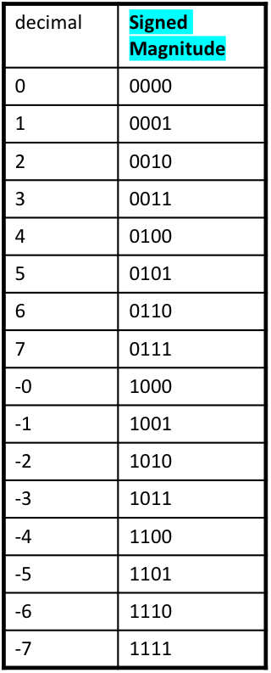
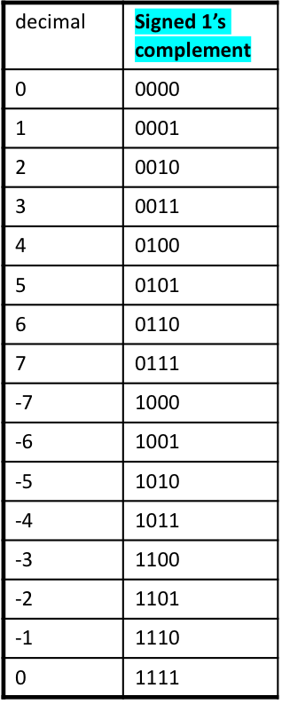
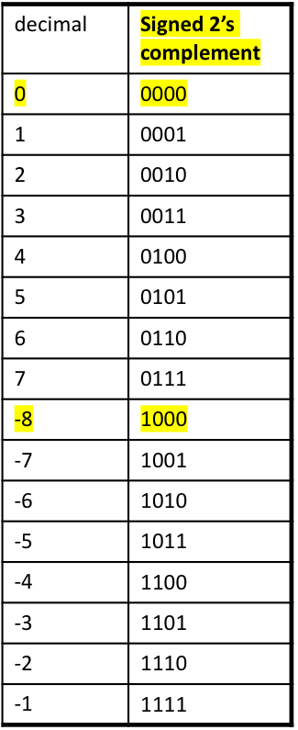
Representing Positive and Negative Numbers
One option
Extra bit needed to carry sign information
“MSB” is often the sign bit
Sign bit = 0 represents non-negative nos.
Sign bit = 1 represents negative numbers
Unique zero
representation
magnitude
2^{n-1} – 1
positive nos.
magnitude
magnitude
2’s comp. of
0 and -8 are themselves
magnitude
magnitude
2^{n-1}
negative nos.
magnitude

Slide 25
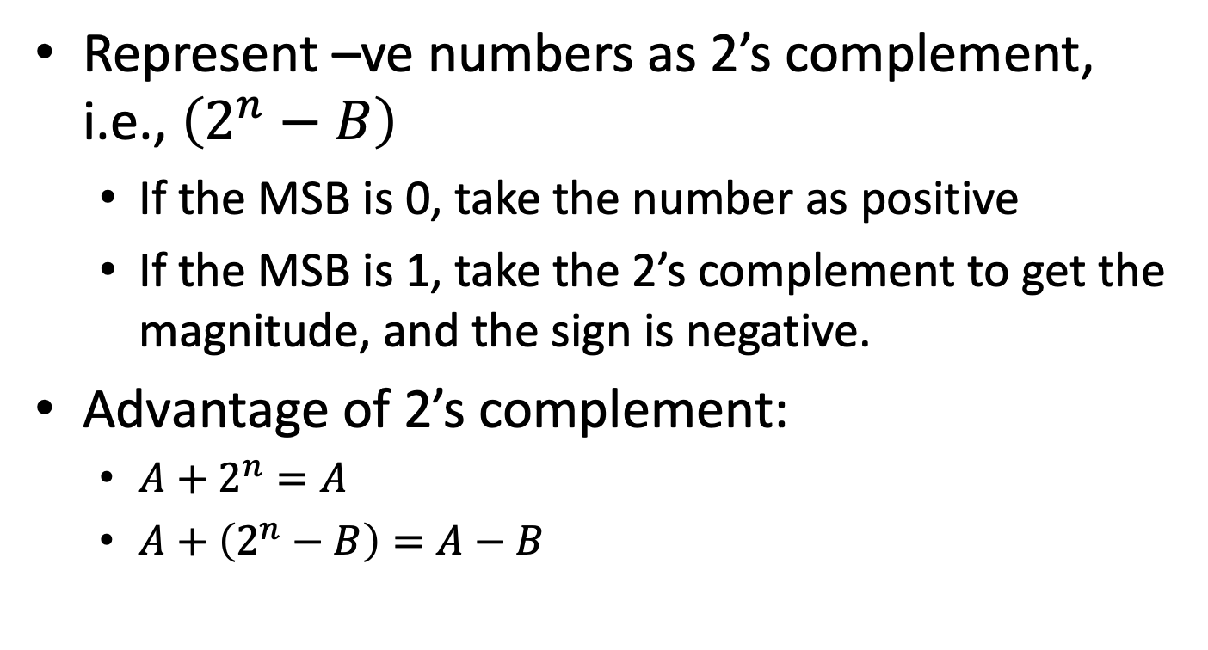
Summary
Represent –ve numbers as 2’s complement, i.e., $\left(2^{n}−B\right)$
If the MSB is 0, take the number as positive
If the MSB is 1, take the 2’s complement to get the magnitude, and the sign is negative.
Advantage of 2’s complement:
$A+2^{n}=A$
$A+\left(2^{n}−B\right)=A−B$

Slide 26
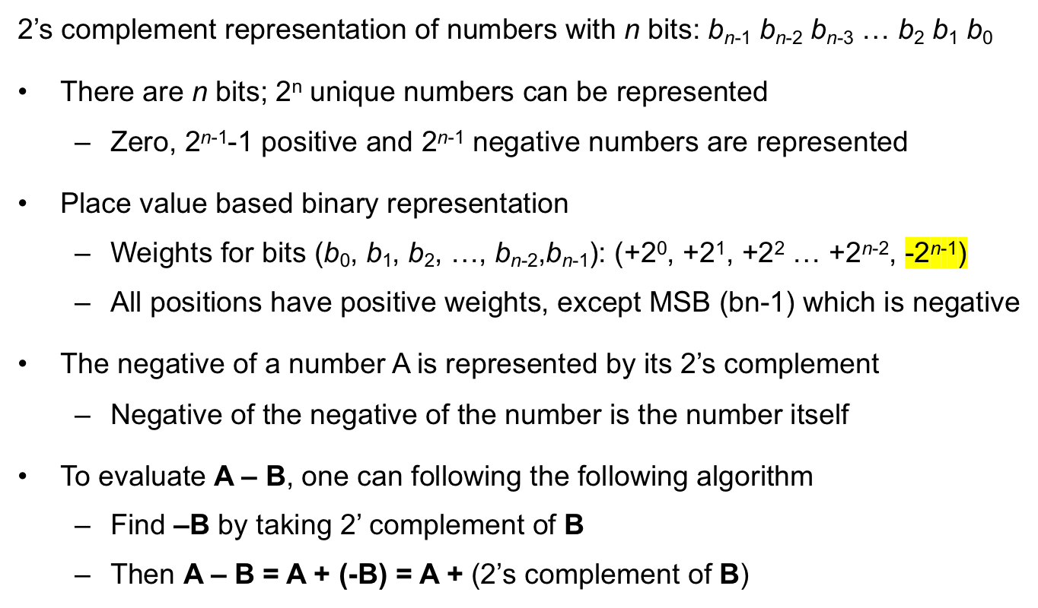
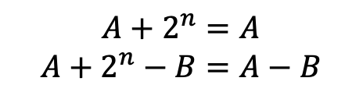
Arithmetic with 2’s Complement
for LSB
for MSB
$$A+2^{n}=A$$
$$A+2^{n}−B=A−B$$

Slide 27
Example
Adding or subtracting numbers with addition operation alone
2’s comp.
of +2
2’s comp.
of +5
2’s comp.
of +5
2’s comp.
of +2
2’s complement is 0011 = 3
2’s complement is 0111 = 7

